Slide 1
Confidence Intervals

Slide 2



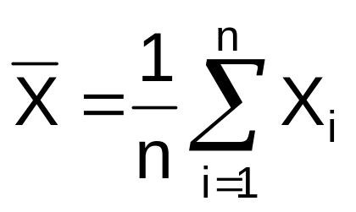
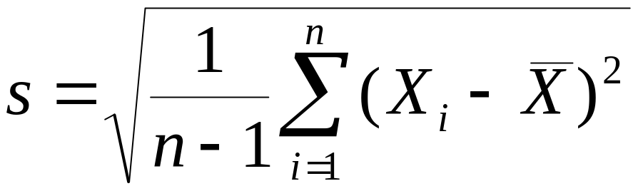
Statistical Estimation
sample statistic = parameter estimate
=
s =
Example:

Slide 3

Parameters and Statistics
Process parameters, μ and σ
(Model parameters, μ and σ)
Sample statistics, and s
Statistical inference
  inferring knowledge of μ and σ, unknown,
  from values of and s, calculated from data

Slide 4
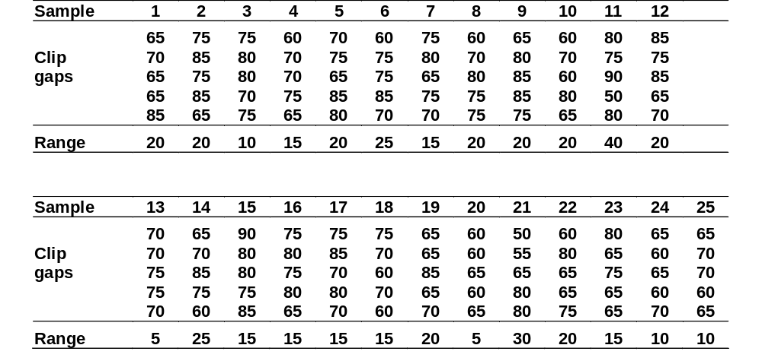
Clip gap measurements in twenty five samples of five measurements each

Slide 5
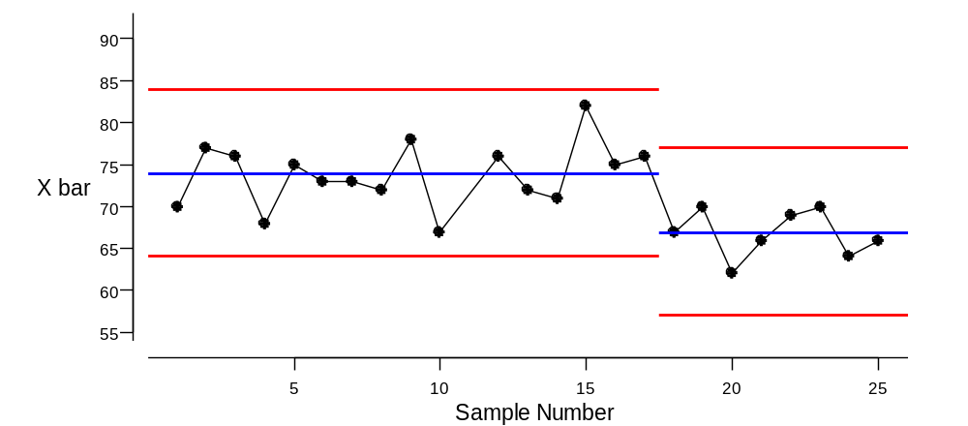
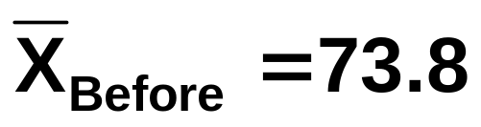
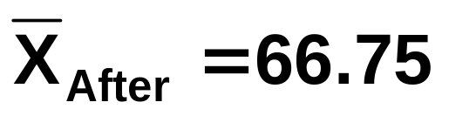
Plot subgroup means

Slide 6
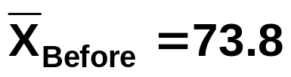
Estimation : how do we quantify the implied uncertainty?
Based on the 16×5 = 80 values sampled from the stable process before the new batch of raw material, can we estimate the process mean?
How do we represent the uncertainty associated with this estimate?
Evaluating the estimate in light of its implied uncertainty, would we conclude that the process is “on target” ?

Slide 7
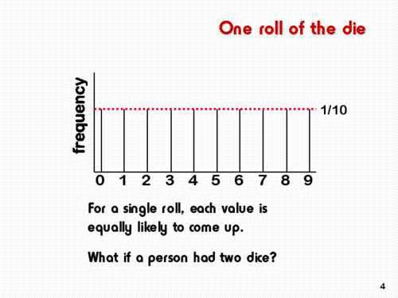

Slide 8
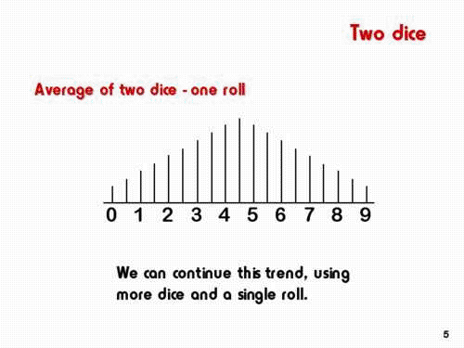

Slide 9
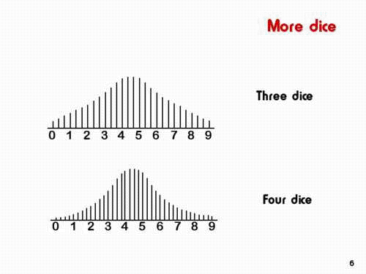

Slide 10
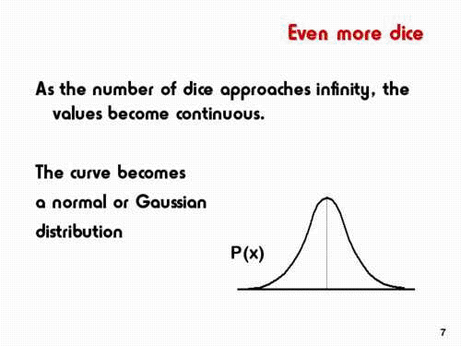

Slide 11
It is unlikely that two samples of the same size taken from the sample population would return exactly the same value for the sample mean. The sample mean will vary from sample to sample.
The sample mean is itself a random variable
with its own population mean
its own standard deviation (called the standard error)
and its own distribution (sampling distribution of the mean)
Properties of the sampling distribution of the mean
The sampling distribution of the mean turns out to be a normal distribution. (see diagrams below).
This is always true if the underlying distribution of the variable is itself normal; but even more importantly, it is approximately true as long as the distribution of the original variables is not very skewed, and the approximation improves as the sample size (n) increases.

Slide 12
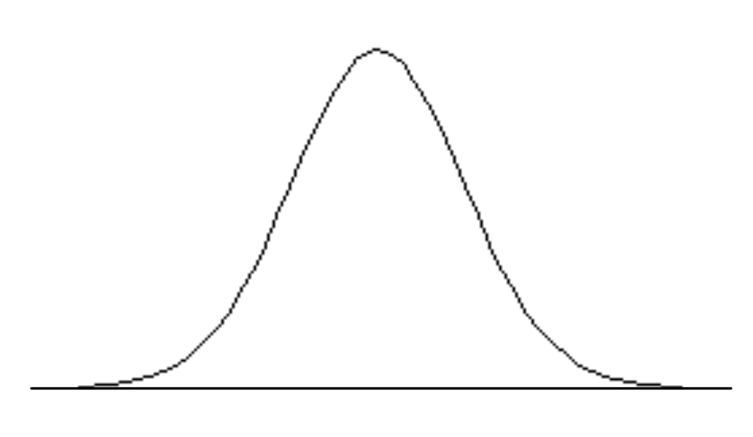
μ
μ
μ
μ
μ
μ
The second result which is of concern relates to the mean of all the sampling means in the sampling distribution of the mean.
Fairly reasonably it turns out to be nothing more than the mean (μ) of the population from which the samples were chosen.
Thus, sample means, are distributed normally about an unknown population mean which is being estimated.
This justifies the intuitive notion that most of the possible sample means should be fairly close to this population value.

Slide 13
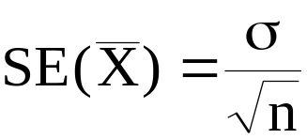
The sample mean should be fairly near to the population mean. The question arises of how near is fairly near, which, of course, relates to the dispersion of the sample means around the population mean.
It can be shown that the standard deviation of the sampling distribution of the mean (more usually called the standard error of the mean, or, when there is no ambiguity, the standard error) is given by 
where σ is the standard deviation of the original population, and n is the sample size.
Thus, estimates based on a large sample size are more precise than estimates associated with small samples.
- Why?

Slide 14
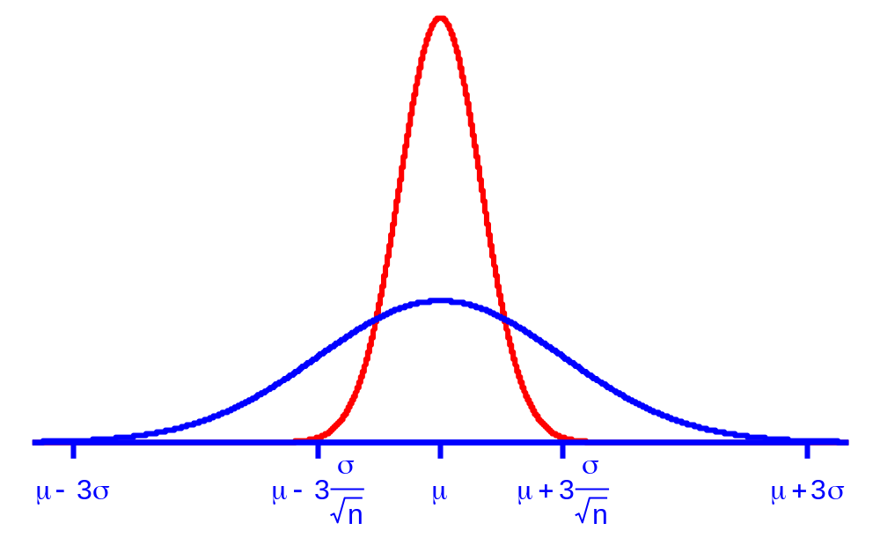
The Normal model for X and for X-bar

Slide 15
Implications of the standard error formula
is very likely to be within 2 standard errors of μ and is even more likely to be within 3 standard errors of μ.
This means that, having calculated a value of from sampled data, we can be reasonably confident that μ is within 2σ/√n of the calculated value and even more confident that μ is within 3σ/√n of the calculated value

Slide 16
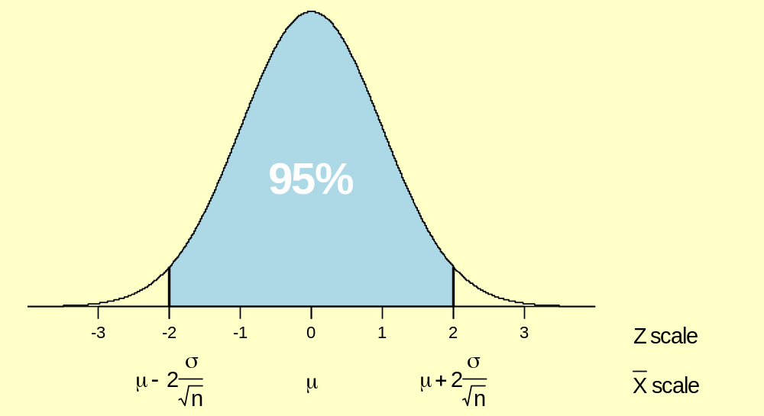
Sampling distribution of X-bar
95% chance that X-bar is within 2σ/√n of μ,
therefore,
95% confident that μ is within 2σ/√n of X-bar

Slide 17
Logic of confidence intervals
With repeated sampling from the process, n at a time and calculating a new value of each time, expect 95% of the calculated values of to be within two standard errors of μ.
Changing emphasis, expect that, in 95% of samples from a stable process, μ will be within two standard errors of the calculated value of .
Therefore, given a single sample from the process, we are 95% confident that the value of μ will be within two standard errors of the calculated value of .

Slide 18
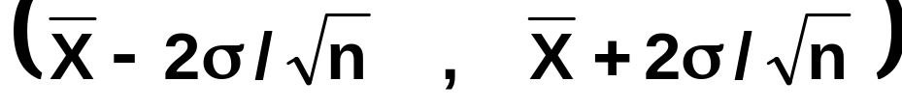
95% confidence interval for μ
that is,
all values of μ within 2 standard errors of

Slide 19
Example
s = 7.3 n = 80.
Confidence interval for μ_{Before} is:
73.8 - 2 × 7.3/√80 to 73.8 + 2 × 7.3/√80,
72.2 to 75.4 .

Slide 20
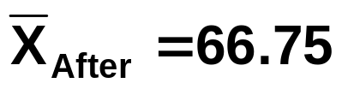
Exercise
s = 7.3 n = 40.
Calculate a confidence interval for μ_{After}

Slide 21
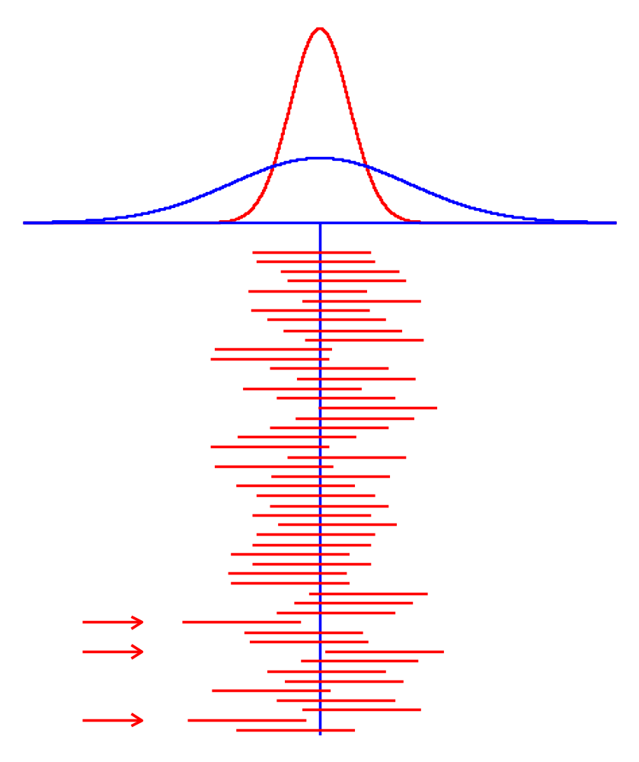
50 simulated confidence intervals

Slide 22
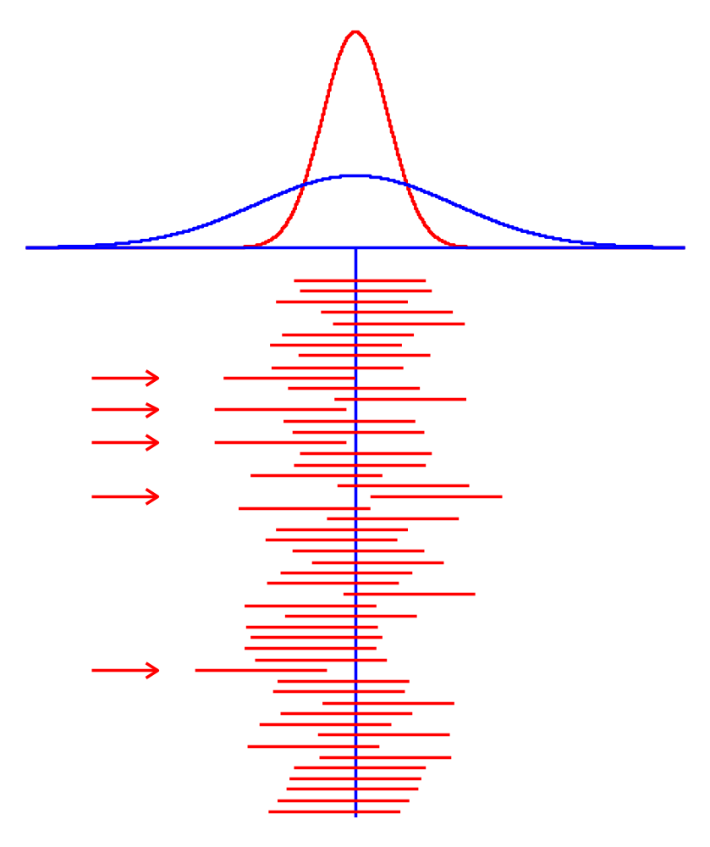

Slide 23
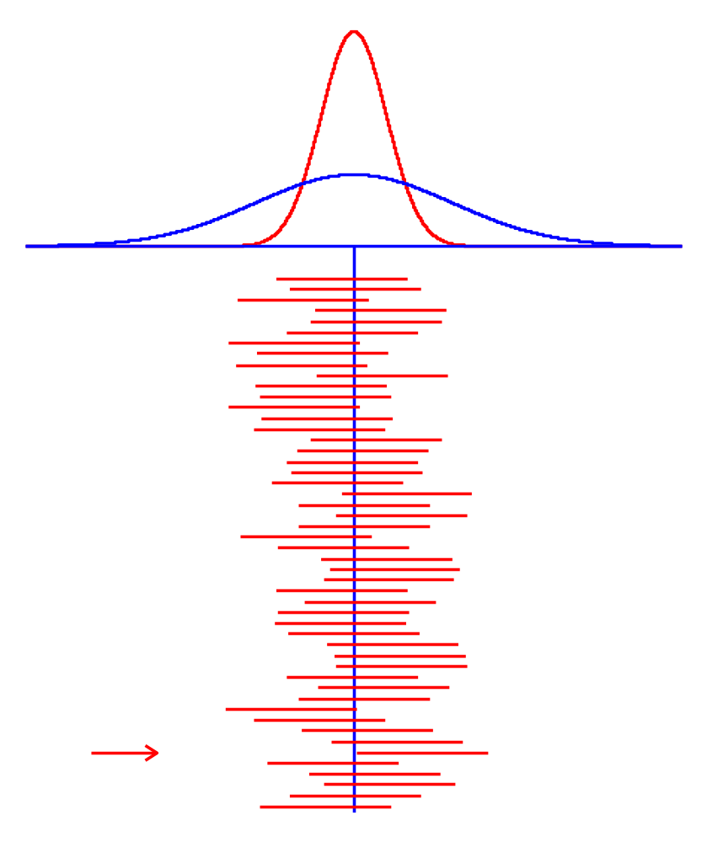

Slide 24
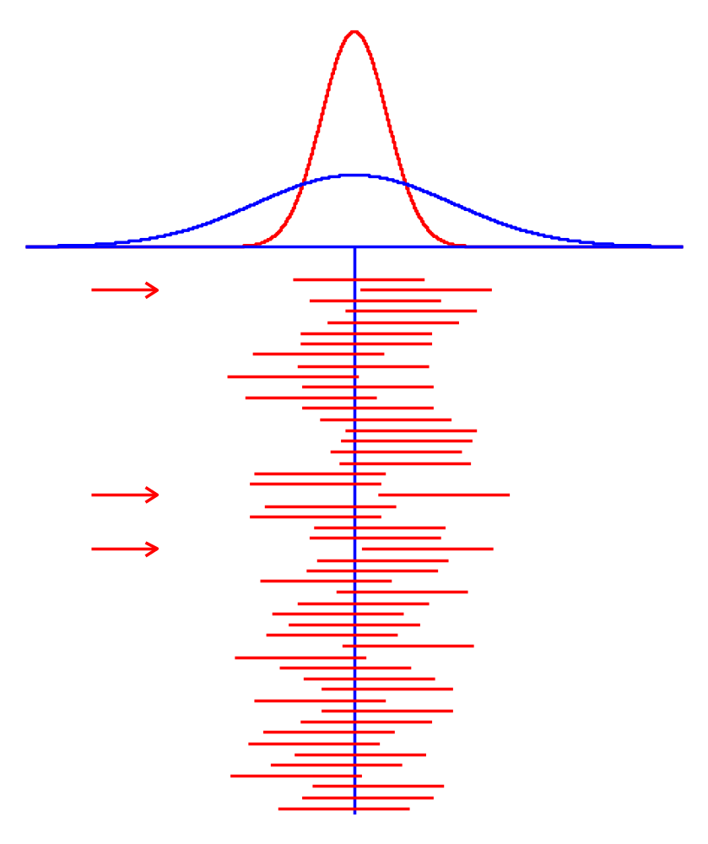

Slide 25
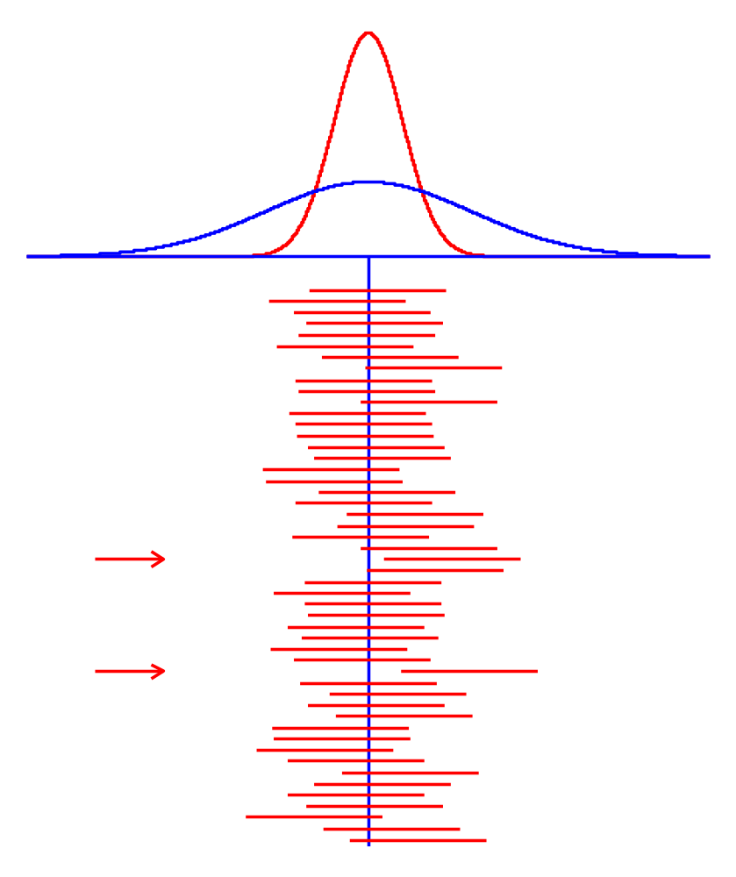

Slide 26
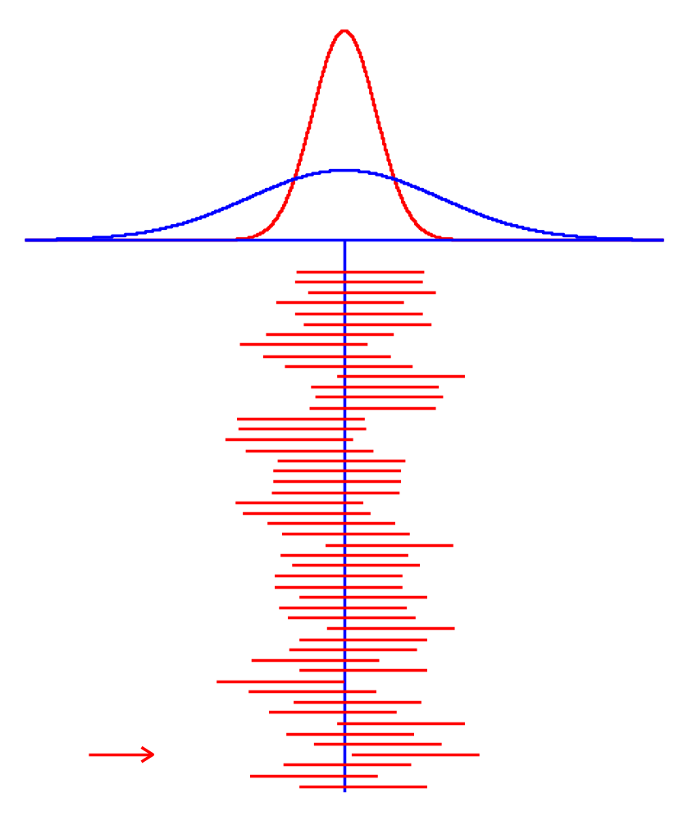

Slide 27

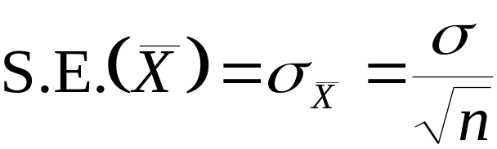
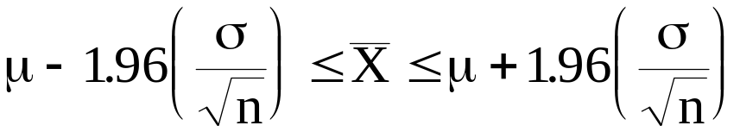
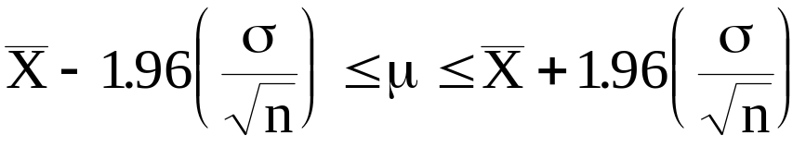
The value 2 is an approximation to the value 1.96 from the normal tables.
The Normal
model for
μ
95% of sample means lie in the range given by

Slide 28
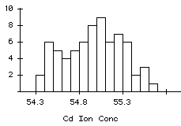
Problem Name: Cadmium Ion Concentration in Sludge
Application: Interval Estimation of a Population Mean
Problem Description: 70 determinations of the Cd²⁺ ion concentration were made. The data showed a sample mean of 54.97 mg/ml and a standard deviation of 0.33 mg/ml.
Our best estimate of μ is 54.97 mg/ml, but what level of confidence do we place in this figure?
What we require is an INTERVAL ESTIMATE.

Slide 29
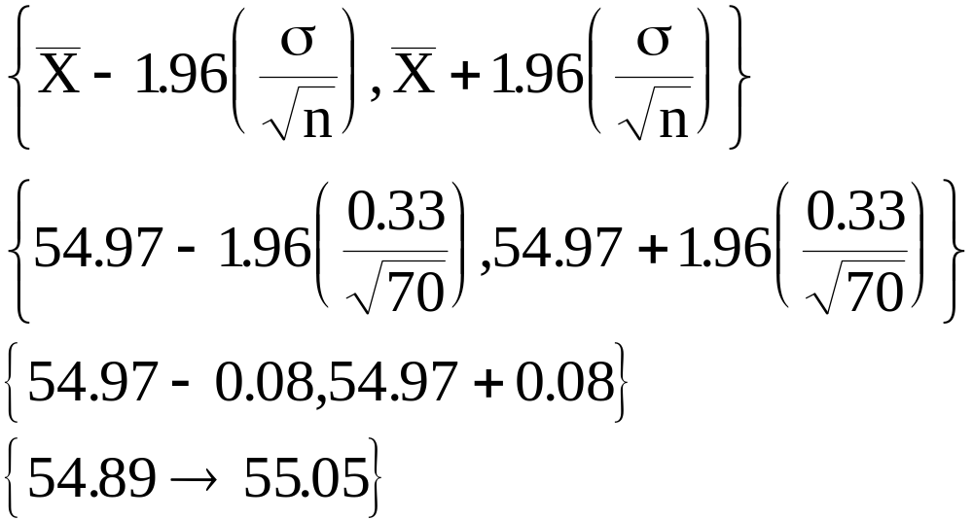
Example: 95% CI for Mean Cadmium Ion Concentration
A 95% confidence interval for the true mean Cadmium ion concentration is calculated as
Under repeated sampling we would expect the true mean Cadmium ion concentration to lie in an interval constructed in such a fashion, 95% of the time.

Slide 30
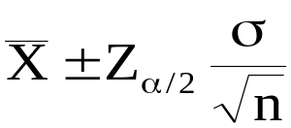
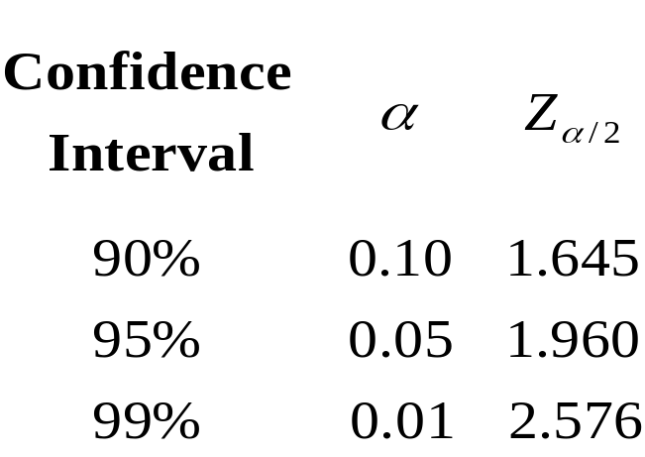
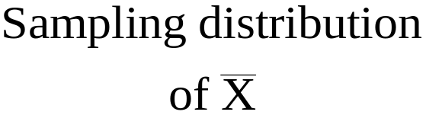
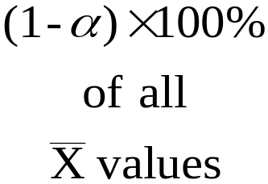

General Procedure: Interval estimate of a population mean
where 1 - α is the confidence level.
μ

Slide 31
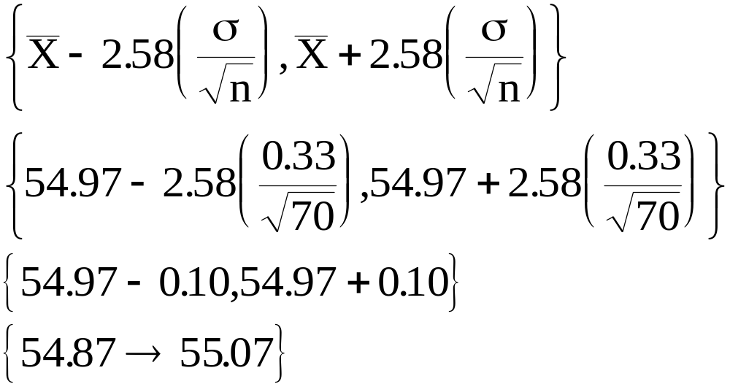
Example: 99% CI for Mean Cadmium Ion Concentration
A 99% confidence interval for the true mean Cadmium ion concentration is calculated as
Under repeated sampling we would expect the true mean Cadmium ion concentration to lie in an interval constructed in such a fashion, 99% of the time.

Slide 32
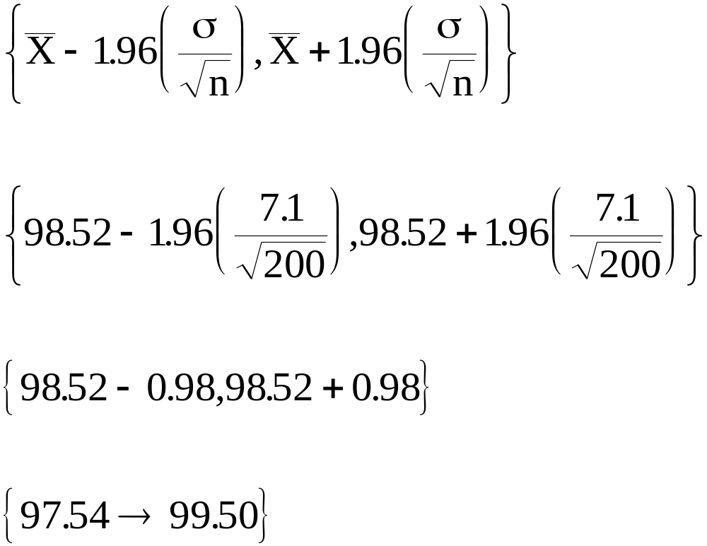
Example: Tablets require an average weight of 100mg. An inspector takes a sample of 200 tablets and finds that
A 95% CI is
Quality engineer says that this interval is “too wide”!

Slide 33
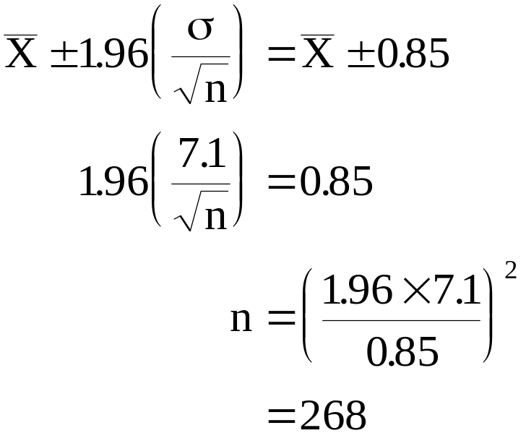
Example: What sample size would be required to estimate the mean weight of tablets to within + 0.85mg, using a 95% C.I.?
Thus, in order to achieve the desired precision in our estimate of the population mean we should use a sample of size 268.

Slide 34
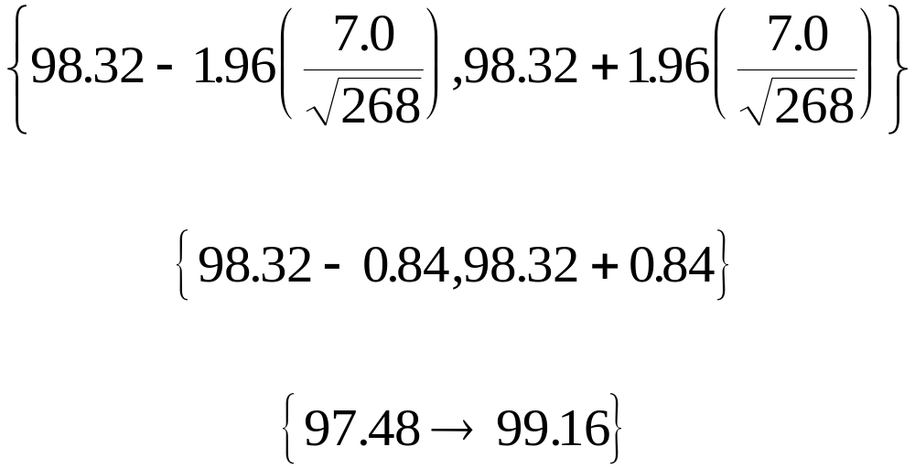
Suppose a new sample gave

Slide 35
# The normal core body temperature of a healthy, resting adult human
# being is stated to be at 98.6 degrees Fahrenheit. We will consider
# data reported by Mackowiak et al., JAMA 268:1578-1580, 1992. TRY...
temps = read.table("C:/Kev/MA4413/data/Mackowiak.txt", header=TRUE)
temps
boxplot(temp ~ gender, data = temps)
abline( h = 98.6, col = "green", lty=2, lwd=2)
stats = function(x) c(mean(x),sd(x),sd(x)/sqrt(length(x)))
CI = function(x, w=1.96) mean(x) + c(-1,1) * w *
sd(x) / sqrt(length(x))
with(temps, by(temp, gender, stats))
with(temps, by(temp, gender, CI))
means = with(temps, by(temp, gender, mean))
CIs = with(temps, by(temp, gender, CI))
lines(x = c(1,1), y = CIs$female, col = "red", lwd = 3)
lines(x = c(2,2), y = CIs$male, col = "red", lwd = 3)
points(x = 1:2, y = means, pch = 16, col = "blue", cex=1.5)

Slide 36
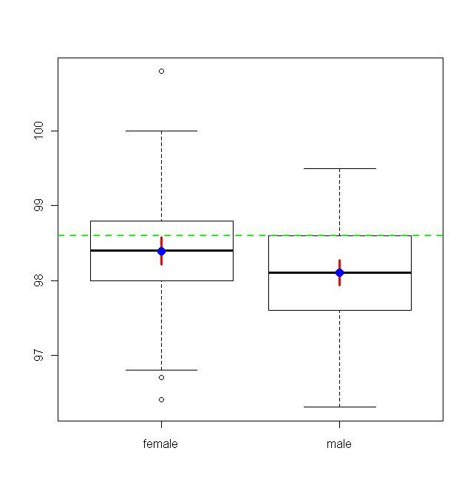

Slide 37
Example: Rental Costs
A reporter for a student newspaper is writing an article on the cost of off-campus housing.
A sample of 10 one-bedroom units within a half-mile of campus resulted in a sample mean of €550 per month and a sample deviation of €30.
Calculate a 95% confidence interval estimate of the mean rent per month for the population of one- bedroom units within a half-mile of campus.
We’ll assume this population to be normally distributed.

Slide 38

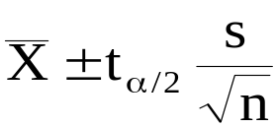
Interval Estimation of a Population Mean
Small-Sample Case (n < 30)
If the data have a normal probability
distribution and the sample standard
deviation s is used to estimate the
population standard deviation σ,
the interval estimate is given by:
where t_{α/2} is the value providing an
area of α/2 in the upper tail of a
t distribution with n-1 degrees of freedom.

Slide 39
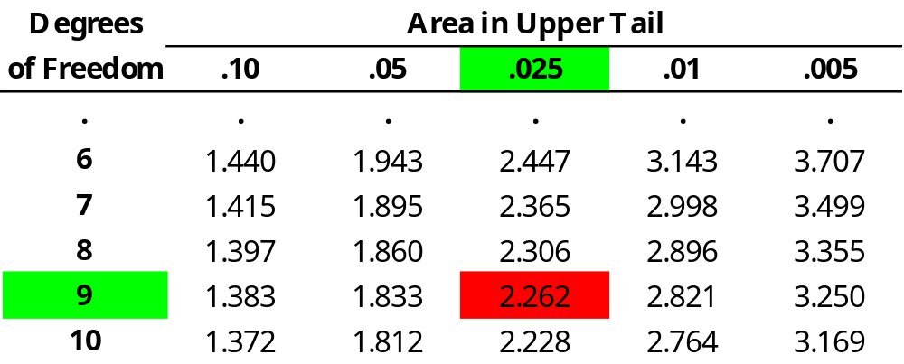
Example: Apartment Rents
t Value
At 95% confidence, 1 - α = .95, α = .05, and α/2 = .025.
t_{.025} is based on n - 1 = 10 - 1 = 9 degrees of freedom.
In the t distribution table we see that t_{.025} = 2.262.

Slide 40
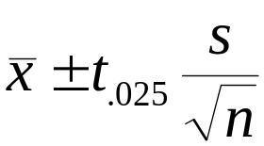
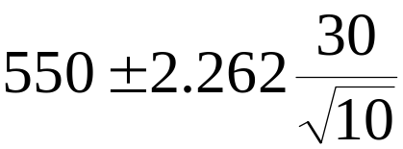
Example: Apartment Rents
Interval Estimation of a Population Mean:
Small-Sample Case (n < 30) with σ Unknown
550 + 21.46
or $528.54 to $571.46
We are 95% confident that the mean rent per month for the population of one-bedroom units within a half-mile of campus is between $528.54 and $571.46.

Slide 41
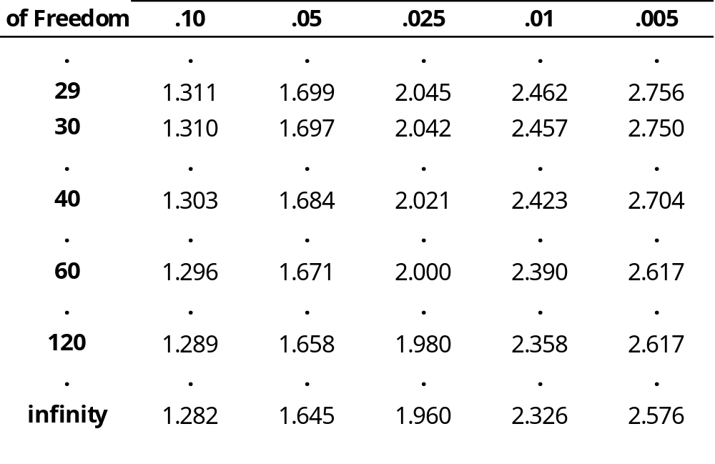
Percentage points of the t Distribution

Slide 42
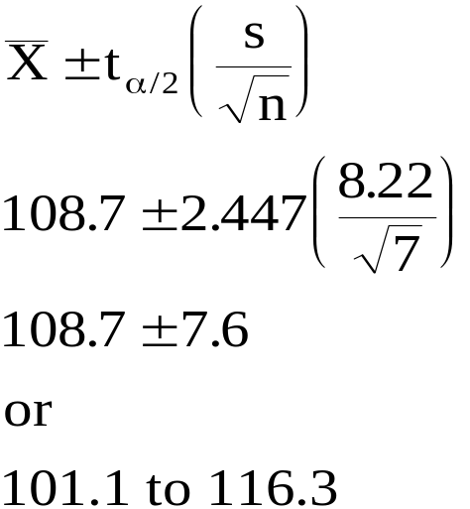
Problem Description: A quality control inspector weighs the contents of 7 packets of breakfast cereal all from the same filling machine. The data recorded were
111g, 117g, 105g, 100g, 97g, 118g, 113g.
Use a 95% confidence interval estimate to determine if the machine is filling to the a priori target value of 115 grams per pack.
At 95% confidence, 1-α = 0.95 and α = 0.05.
t-dist on 6df
-2.447
+2.447

Slide 43
TRY:
w = c(111, 117, 105, 100, 97, 118, 113)
n = length(w)
qt(0.975, df = n - 1)
qt(0.025, df = n - 1, lower.tail = FALSE)
mean(w) +c(-1,1) * qt(0.975, df = n - 1) * sd(w) / sqrt(n)
t.test(w)$conf #the R function t.test does all this
qqnorm(w) #test the assumption of normal data!!

Slide 44
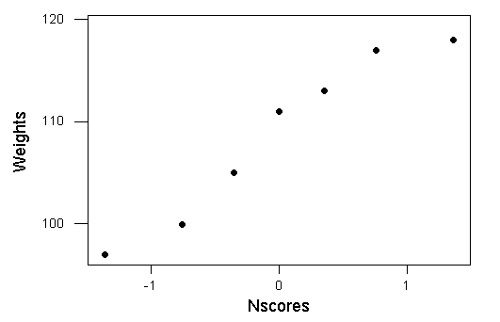
N-Score Plots: Testing the assumption of normality
NSCORES are idealised values we would expect if the data came from a normal distribution.
Use Z values {Z₁…Z₇} that divide the standard curve normal into 8 sections, with the area to the left of each Z equal to (i - 1/2)/n of the total area, where n = 7 and i runs from 1 to 7 in this example.
The assumption of normality of the Weight data is being tested.
If the points fall on a line then the assumption of normality is not called into question!

Slide 45


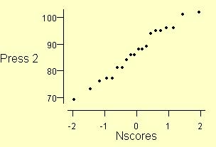
Normal scores and the Normal diagnostic plot

Slide 46
Normal diagnostic plot
If the sampled process follows the Normal model, the similarity of the spacing patterns will lead to a straight line scatter plot pattern, with some chance variation.
If the scatter plot pattern is not a straight line with some chance variation, then the conclusion is that the sample process does not conform to the Normal model.

Slide 47
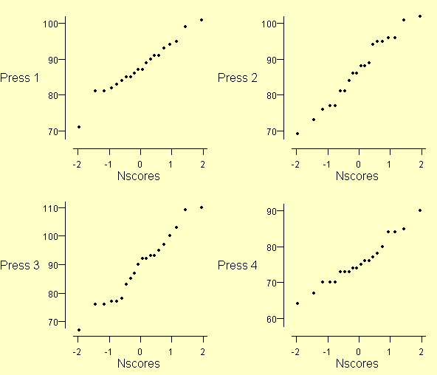
Normal diagnostic plot, Presses 1-4

Slide 48
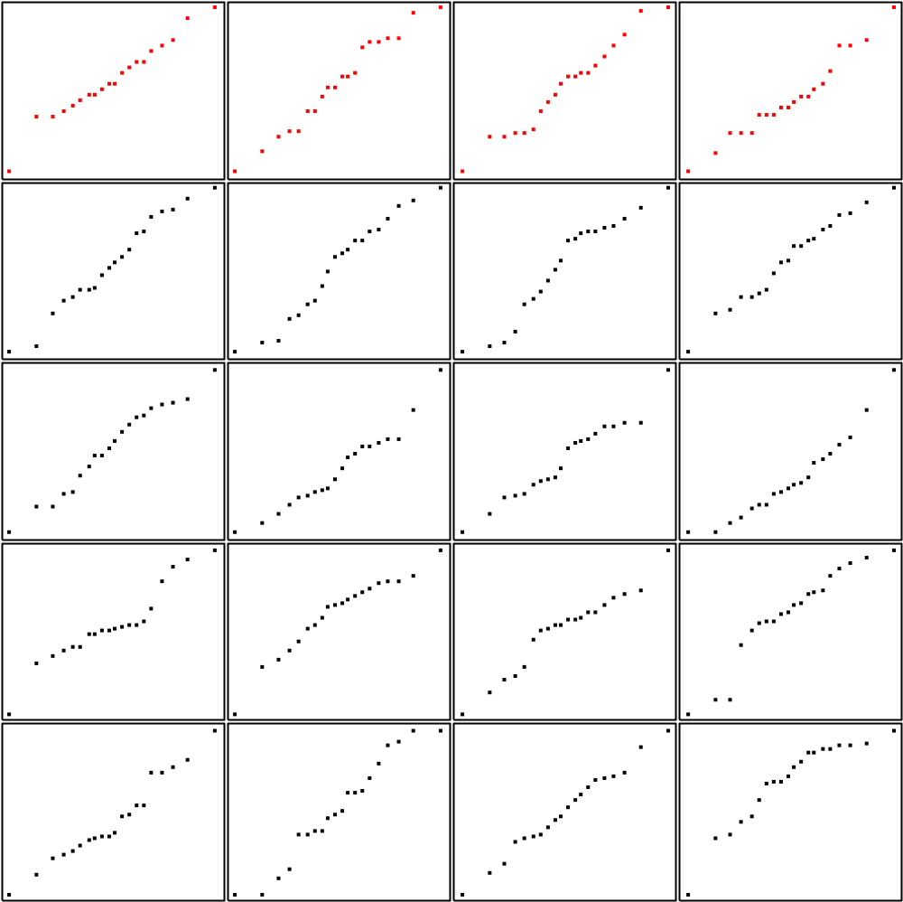
Reference plots

Slide 49
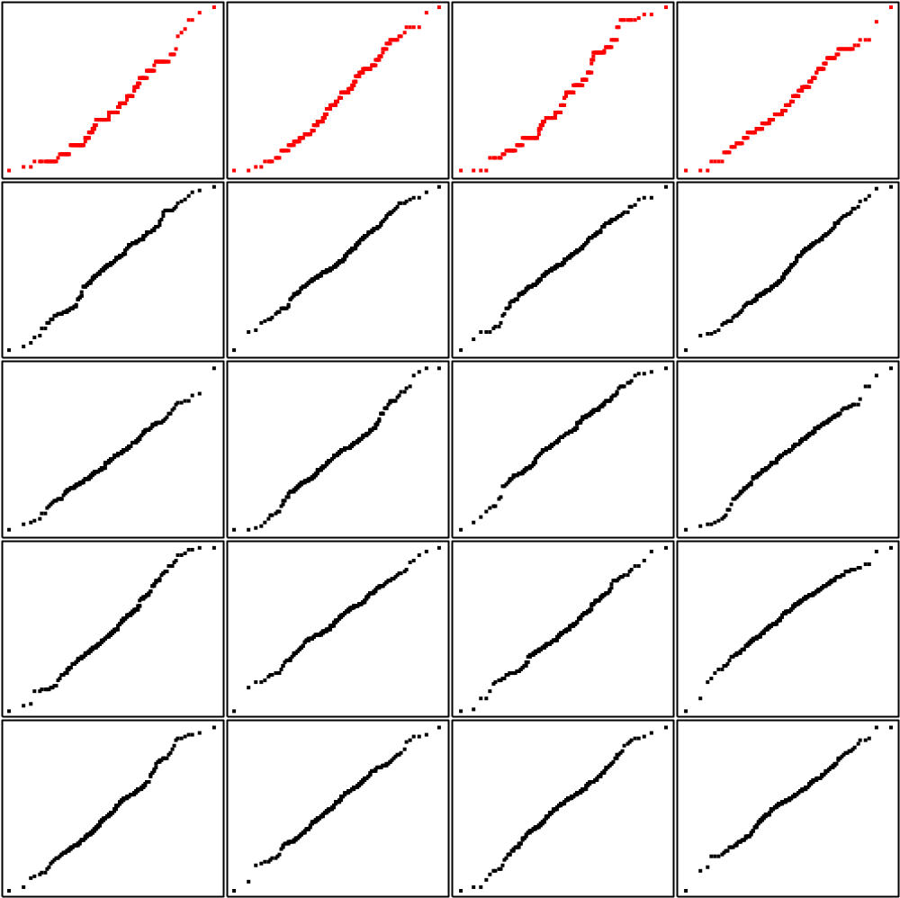
Normal plot, Presses 1-4, all data, with reference plots

Slide 50
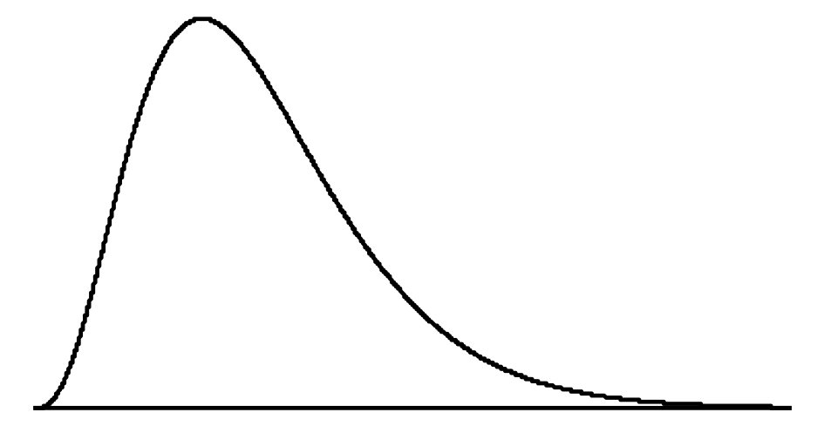
A skew frequency curve

Slide 51
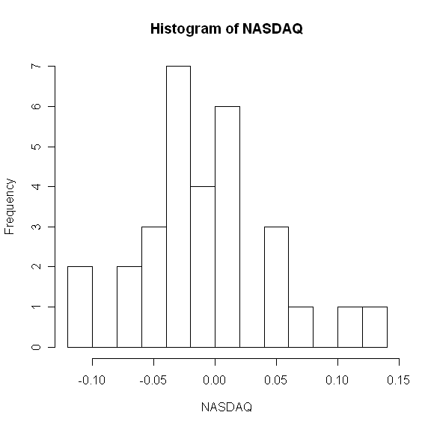
Return on Stocks

Slide 52

Assumption of Normality??

Slide 53
Sample Statistics and t-value from tables
Sample mean: Xbar = -0.00983
Standard Deviation: s = 0.055
Sample size: n = 30
t Value
At 95% confidence, 1 - α = .95, α = .05, and α/2 = .025.
t_{.025} is based on n - 1 = 30 - 1 = 29 degrees of freedom.
In the t distribution table we see that t_{.025} = 2.045
Verify that the 95% CI estimate is -0.0304 % TO 0.0107 %

Slide 54

Prediction Intervals
Confidence interval:
Prediction interval:
Verify that the 95% PI estimate is -0.125 % TO 0.105 %

Slide 55



Confidence Interval For A Proportion
Suppose that 46 respondents of a sample of 140 students claim to attend lecturers. The sample proportion is = 46/140 = 0.33, a 95% confidence interval for the population proportion p is required.

Slide 56

In general a confidence interval is constructed as
Point Estimate + Value*SE(Point Estimate)

Slide 57

Sample Size
Suppose that the research team are unhappy about the width of the interval and say that in future they would like estimates in the form
X% + 2%
To achieve this level of precision in the estimate how large must the sample be??

Slide 58
Since p is unknown this expression cannot be evaluated immediately. Consider the following table:
    p 1-p p(1-p)
    .1 .9 .09
    .2 .8 .16
    .3 .7 .21
    .4 .6 .24
    .5 .5 .25
    .4 .6 .24
p(1-p) has a maximum when p = 0.5 - if we use this value we do at least as well as required.

Slide 59


For a 95% confidence interval we have

